Slide 1
HTML 5
Part III

Slide 2
List

Slide 3
List
Numbered List
Bulleted List

Slide 4
Numbered List

Slide 5
Numbered List
List of items can be numbered or ordered is called numbered/ordered
List
Tags can be used for creating ordered list are:
<ol>
<li>
<li> tag
Defines a list item.
Should be used as a child tag of either <OL> or <UL> tag.
<ol> tag
<ol> defines an ordered list.
An ordered list can be numerical or alphabetical.
Attributes in <ol> tag are
start
type

Slide 6
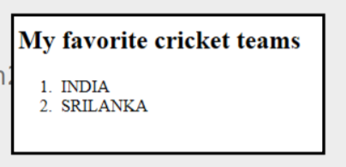
Numbered List
Example (Code)
<!DOCTYPE html>
<html>
<body>
<h2>My favorite cricket teams</h2>
<ol>
<li>INDIA</li>
<li>SRILANKA</li>
</ol>
</body>
</html>

Slide 7
Attributes in <OL> tag
Type Attribute:
Specifies the kind of marked to use in the list
Valid values for the Type Attribute
• A-Uppercase letters
• a-Lowercase letters
• I-Uppercase Roman letters
• i-Lowercase Roman letters
• 1-Standard numbers, default
Start Attribute
Specifies the start value of an ordered list

Slide 8
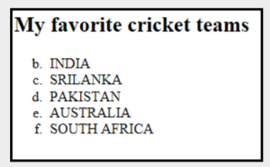
Example
<!DOCTYPE html>
<html>
<body>
<h2>My favorite cricket teams<h2>
<ol start="2" type="a">
<li>INDIA
<li>SRILANKA
<li>PAKISTAN
<li>AUSTRALIA
<li>SOUTH AFRICA
<ol>
</body>
</html>

Slide 9
DEMO
NumberedList.html

Slide 10
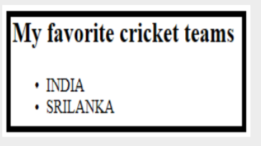
Bulleted List
List of items prefixed with bullets is called Bulleted /Unordered List
<ul> tag
<ul> defines an unordered list.
An unordered list items will be marked with bullets (small black circles).
<!DOCTYPE html>
<html>
<body>
<h2>My favorite cricket teams</h2>
<ul>
<li>INDIA</li>
<li>SRILANKA</li>
</ul>
</body>
</html>

Slide 11
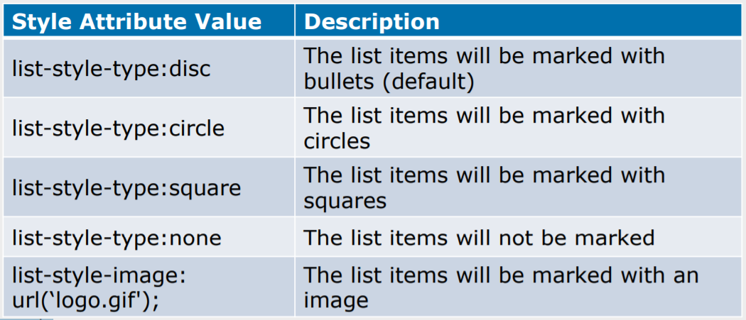
Attributes in <UL> tag
Style Attribute:
Can be used in <UL> tag to define the style of the marker
Example
<UL style=“list-style-type:circle”> will be used to prefix unordered list of items with square.

Slide 12
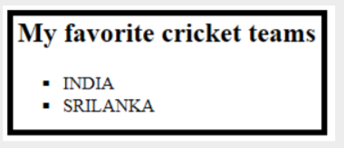
Example (Code):
<!DOCTYPE html>
<html>
<body>
<h2>My favorite cricket
teams</h2>
<ul style="list-styletype:square">
<li>INDIA</li>
<li>SRILANKA</li>
</ul>
</body>
</html>

Slide 13
DEMO
BulletedList.html

